Slide 1
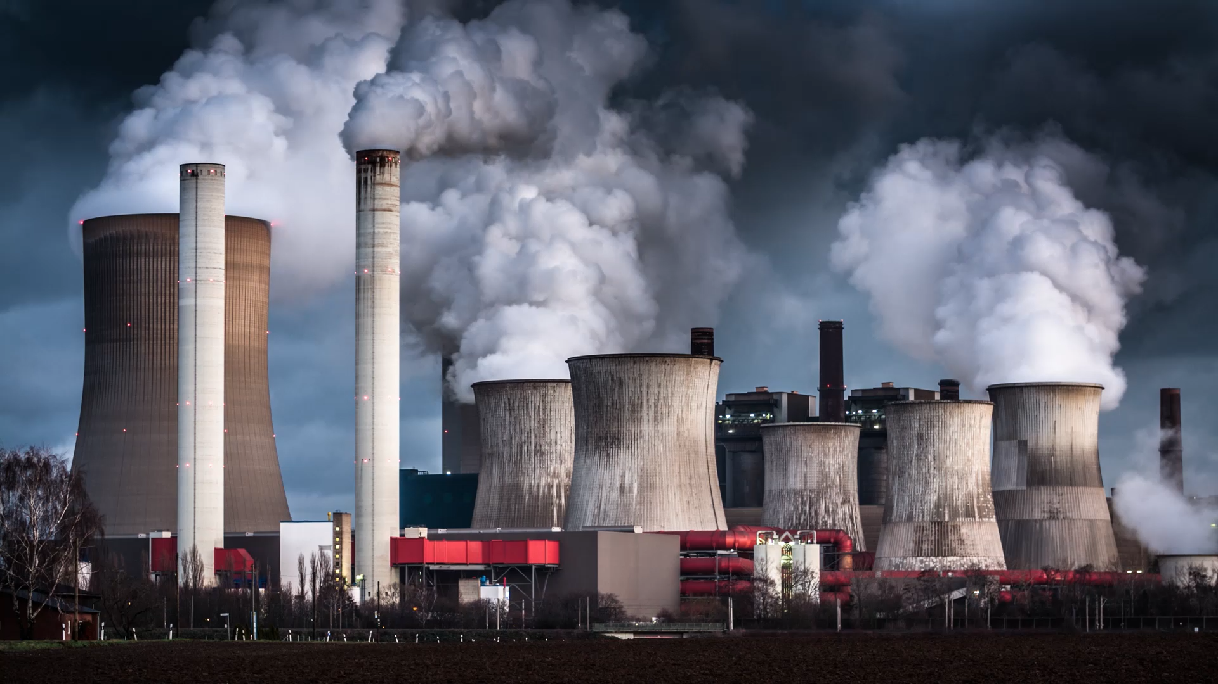
🌍 Air Quality & Pollution Prediction in European Cities
A Multi-Output Machine Learning Approach
UMBC DATA606 – Data Science Capstone Author: RAMIREDDY ROHAN REDDY Instructor: Dr. Chaojie (Jay) Wang University: University of Maryland, Baltimore County

Slide 2

Problem Statement
Air pollution is a major environmental and health issue
Pollutants like PM2.5, PM10, NO₂, O₃ affect human health
Traditional monitoring is reactive, not predictive
Goal: 👉 Predict pollution levels using historical data and weather conditions

Slide 3
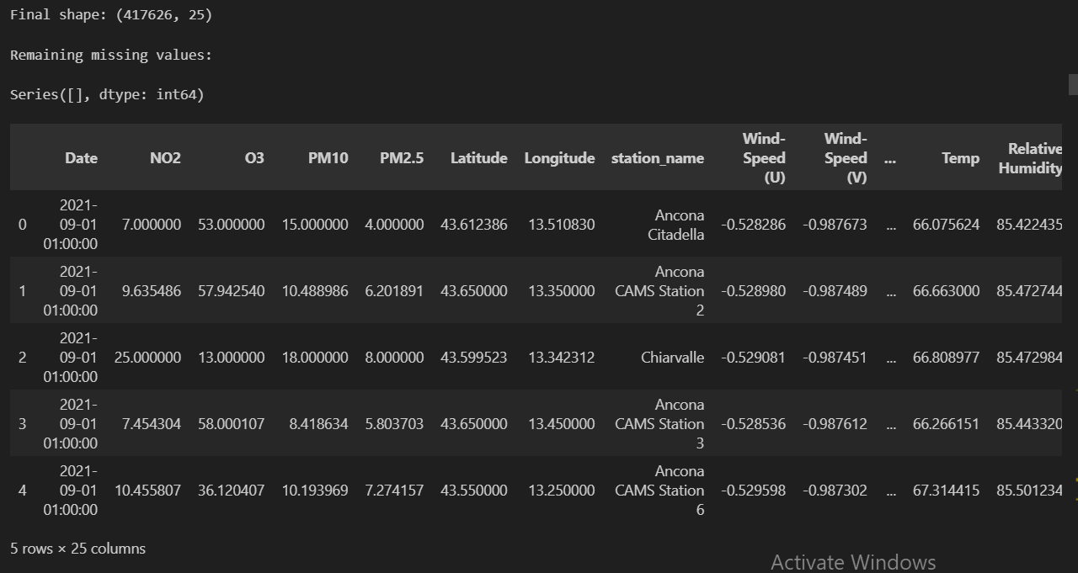
Dataset Overview
Source: European Air Quality Dataset
~1M+ records (large-scale dataset)
Target Variables:
PM2.5, PM10, NO₂, O₃
Input Features:
Temperature
Relative Humidity
Year, Month, Day
Day of Week, Weekend
Preprocessing Steps:
Missing value handling
Data cleaning (non-numeric fixes)
Feature engineering (date-based features)

Slide 4

Data Cleaning & Challenges
📌 Content:
Dataset contained missing values and inconsistent entries
Some columns had non-numeric values (e.g., text in numeric fields)
Presence of outliers and unrealistic values
Large dataset size caused performance issues
🛠 Solutions:
Converted columns using pd.to_numeric(errors='coerce')
Handled missing values using median/mode imputation
Removed/capped outliers using IQR method
Reduced dataset size for faster model training

Slide 5
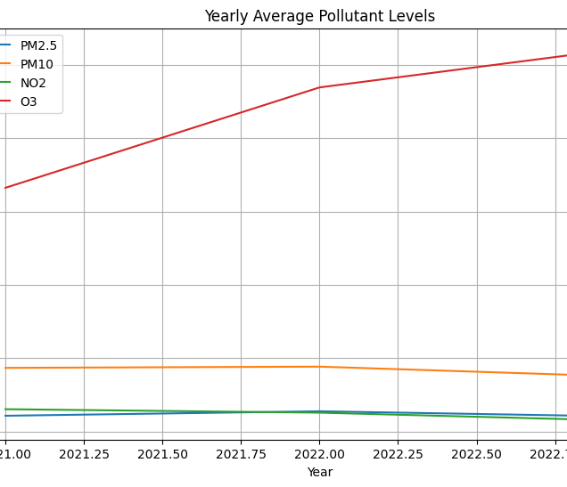
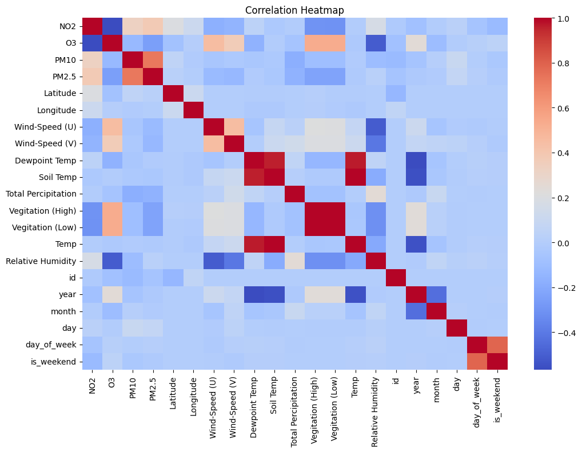
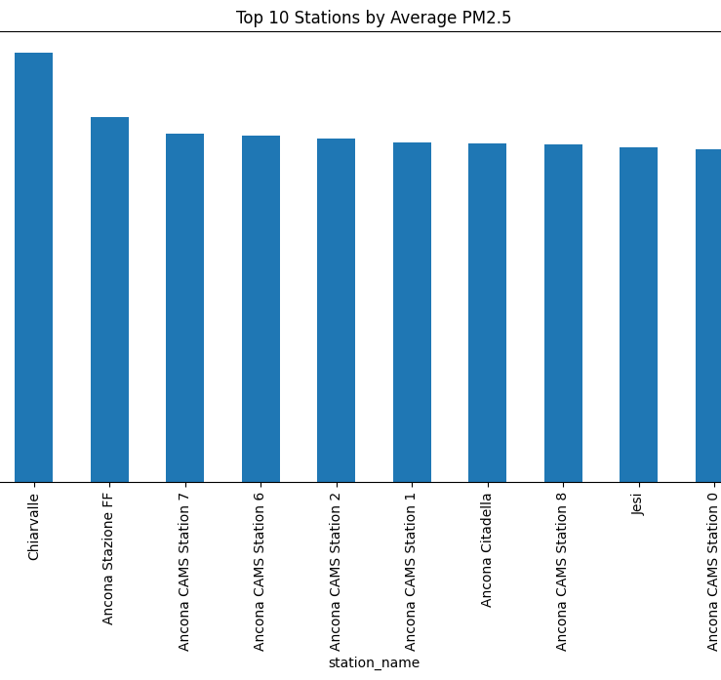
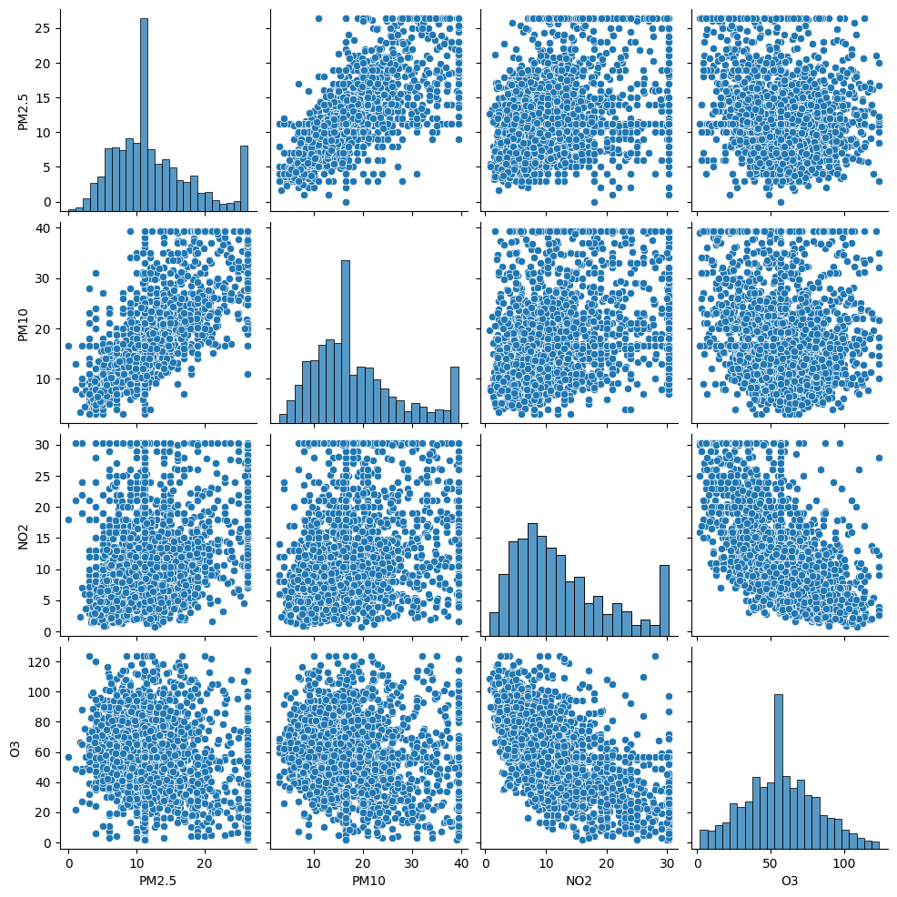
Key Insights from EDA
Seasonal variation in pollution levels
Strong correlation between pollutants
Weather factors impact pollution (Temp, Humidity)
Techniques Used:
Histograms
Correlation heatmap
Monthly & yearly trends
Scatter plots
👉 Helped identify patterns and clean anomalies

Slide 6
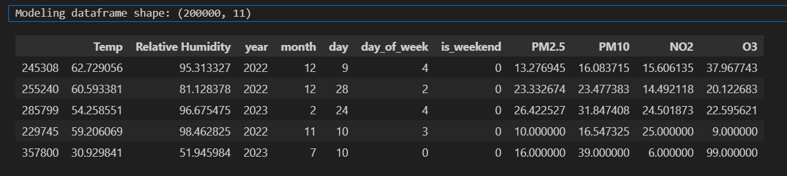
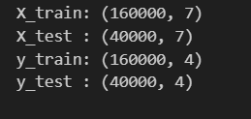
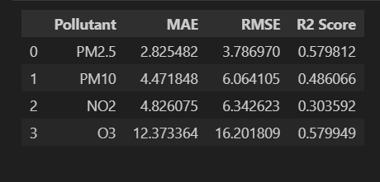
Machine Learning Model
Approach:
Multi-output regression
Predict multiple pollutants simultaneously
Models Used:
Linear Regression (baseline)
Random Forest (final model)
Evaluation Metrics:
MAE (Mean Absolute Error)
RMSE
R² Score
Result: 👉 Random Forest performed better for nonlinear environmental data
Modeling dataframe shape: (200000, 11)

Slide 7
Deployment & Conclusion
Streamlit App Features:
User inputs weather conditions
Real-time prediction of pollutants
Interactive UI with charts
Conclusion:
Successfully predicted multiple pollutants
Weather + time features are important
Model can support environmental monitoring
Future Work:
Add real-time API data
Use advanced models (XGBoost)
Improve UI with AQI categories

